Slide 1
Unit 1. Antennas and Free Space Propagation
ECE-GY 6023. Introduction to Wireless communications
Prof. Sundeep rangan

Slide 2
Learning Objectives
Mathematically describe an EM wave:
Direction of motion, wavenumber, frequency, polarization, …
Identify radio spectrum and power levels used in common commercial wireless products
Perform basic power calculations in dB scale
Perform basic mathematical operations in polar coordinates
Conversions to cartesian coordinates, rotations, integrals, averages, …
Use tools from MATLAB to compute and plot key antenna parameters
Directivity, gain, efficiency, …
Compute received power in an angular region using the radiation density and intensity.
Compute the free-space path loss using Friis Law
Derive Friis Law

Slide 3
Outline
Basics of Electromagnetic Waves
Power and Bandwidth of Signals
Basics of Antennas
Free Space Propagation
Frames of Reference and Rotations

Slide 4
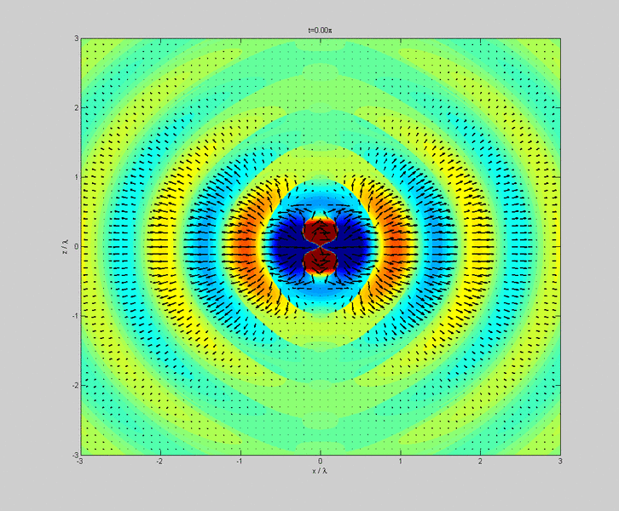
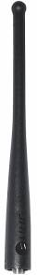
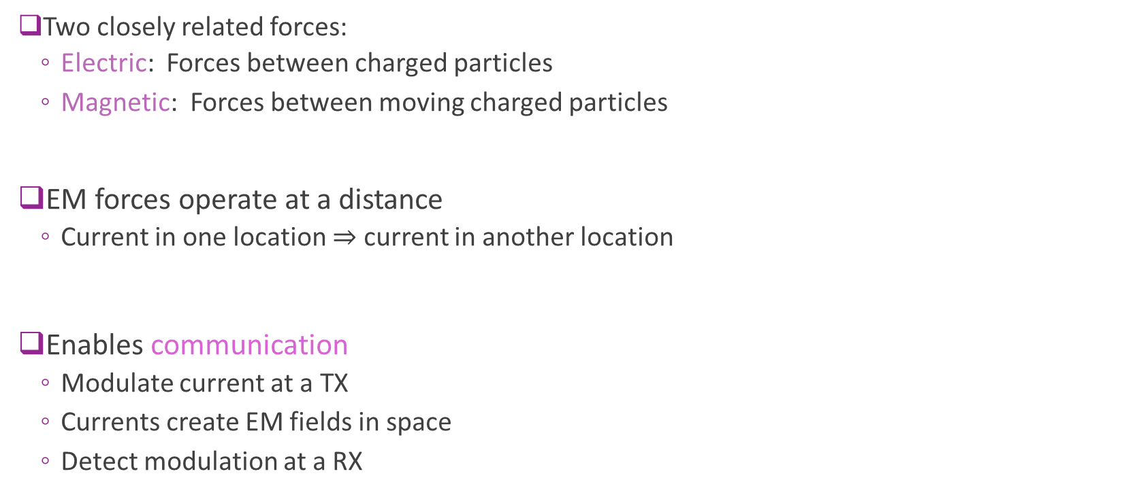
Electric and Magnetic Forces
Two closely related forces:
Electric: Forces between charged particles
Magnetic: Forces between moving charged particles
EM forces operate at a distance
Current in one location $⇒$ current in another location
Enables communication
Modulate current at a TX
Currents create EM fields in space
Detect modulation at a RX
TX
RX

Slide 5
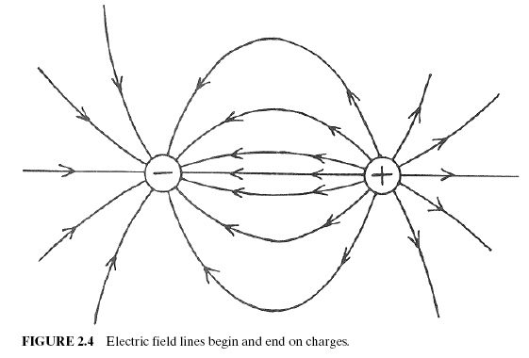
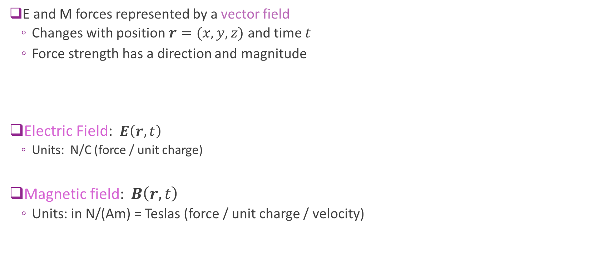
Electric and Magnetic Vector Fields
E and M forces represented by a vector field
Changes with position $r=(x,y,z)$ and time $t$
Force strength has a direction and magnitude
Electric Field: $E\left(r,t\right)$
Units: N/C (force / unit charge)
Magnetic field: $B\left(r,t\right)$
Units: in N/(Am) = Teslas (force / unit charge / velocity)

Slide 6
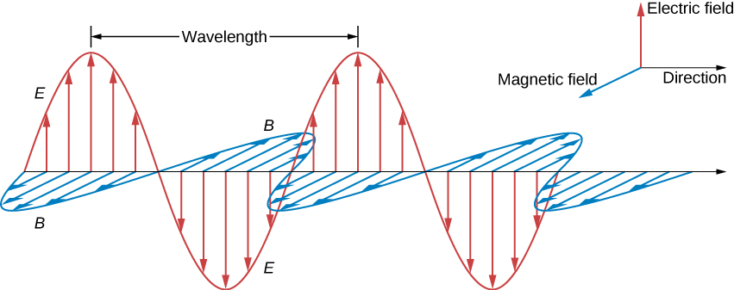
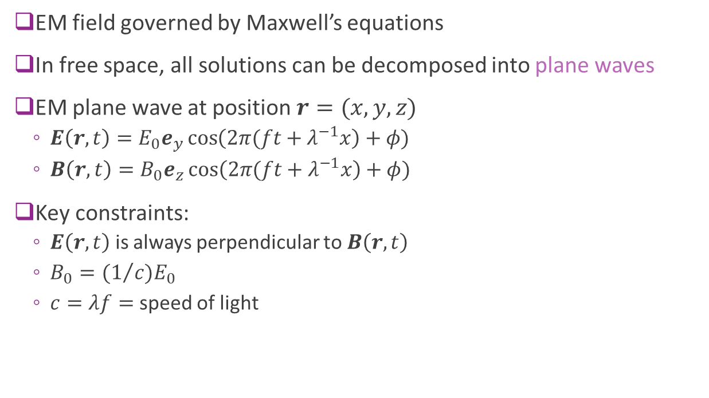
Plane Waves
EM field governed by Maxwell’s equations
In free space, all solutions can be decomposed into plane waves
EM plane wave at position $r=(x,y,z)$
$E\left(r,t\right)=E_{0}e_{y}\cos\left(2π(ft+λ^{−1}x\right)+φ)$
$B\left(r,t\right)=B_{0}e_{z}\cos\left(2π(ft+λ^{−1}x\right)+φ)$
Key constraints:
$E\left(r,t\right)$ is always perpendicular to $B\left(r,t\right)$
$B_{0}={(1}/c)E_{0}$
$c=λf=$ speed of light

Slide 7
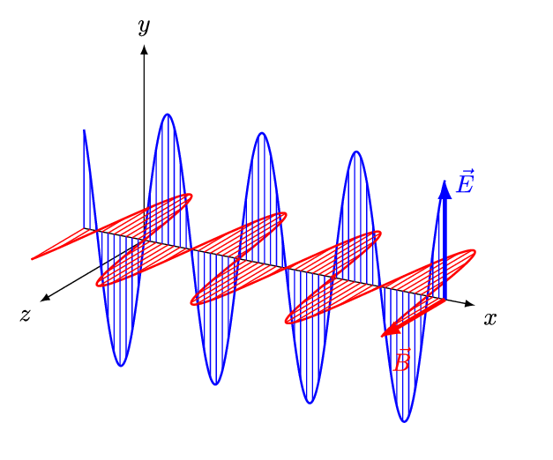
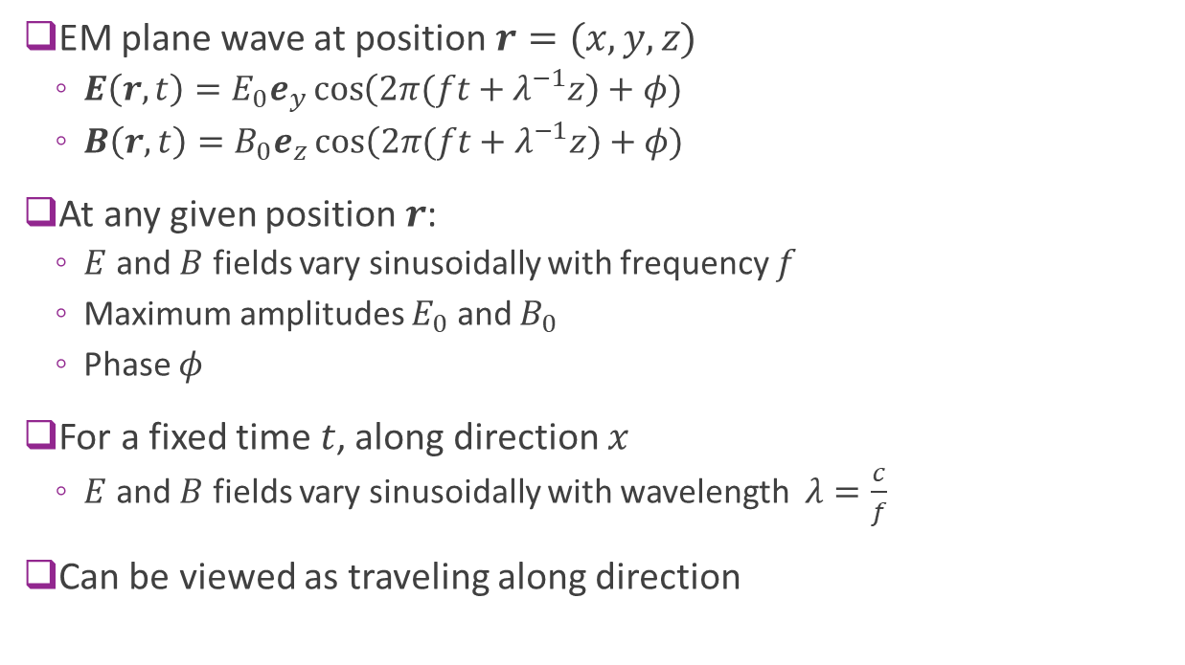
Visualizing Plane Waves
EM plane wave at position $r=(x,y,z)$
$E\left(r,t\right)=E_{0}e_{y}\cos\left(2π(ft+λ^{−1}z\right)+φ)$
$B\left(r,t\right)=B_{0}e_{z}\cos\left(2π(ft+λ^{−1}z\right)+φ)$
At any given position $r$:
$E$ and $B$ fields vary sinusoidally with frequency $f$
Maximum amplitudes $E_{0}$ and $B_{0}$
Phase $φ$
For a fixed time $t$, along direction $x$
$E$ and $B$ fields vary sinusoidally with wavelength $λ=\frac{c}{f}$
Can be viewed as traveling along direction

Slide 8
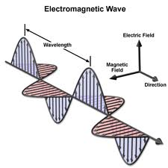
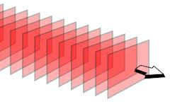
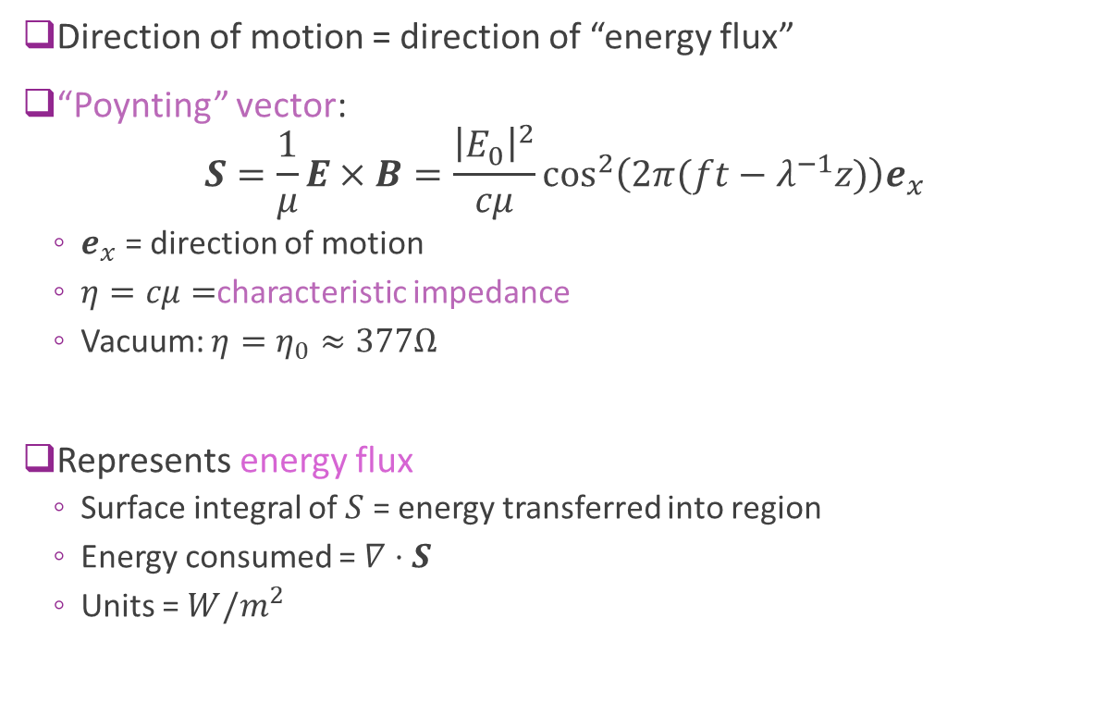
Plane Wave Direction of Motion
Direction of motion = direction of “energy flux”
“Poynting” vector: $S=\frac{1}{μ}E×B=\frac{{\left|E_{0}\right|}^{2}}{cμ}\cos^{2}\left(2π(ft−λ^{−1}z)\right)e_{x}$
$e_{x}$ = direction of motion
$η=cμ=$characteristic impedance
Vacuum: $η=η_{0}≈377Ω$
Represents energy flux
Surface integral of $S$ = energy transferred into region
Energy consumed = $∇⋅S$
Units = $W/m^{2}$

Slide 9
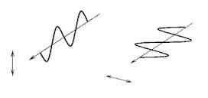
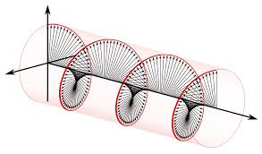
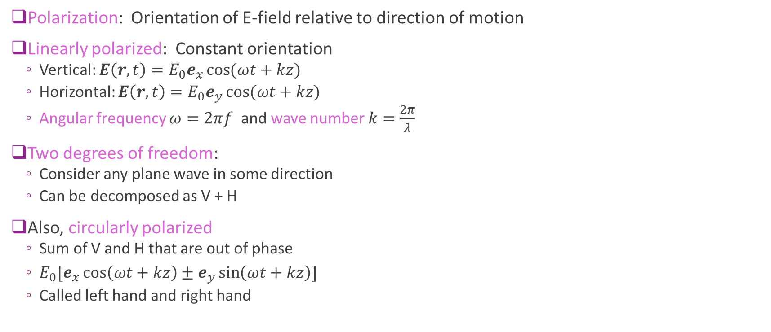
Polarization
Polarization: Orientation of E-field relative to direction of motion
Linearly polarized: Constant orientation
Vertical: $E\left(r,t\right)=E_{0}e_{x}\cos{(ωt+kz)}$
Horizontal: $E\left(r,t\right)=E_{0}e_{y}\cos{(ωt+kz)}$
Angular frequency $ω=2πf$ and wave number $k=\frac{2π}{λ}$
Two degrees of freedom:
Consider any plane wave in some direction
Can be decomposed as V + H
Also, circularly polarized
Sum of V and H that are out of phase
$E_{0}[e_{x}\cos\left(ωt+kz\right)±e_{y}\sin\left(ωt+kz\right)]$
Called left hand and right hand

Slide 10
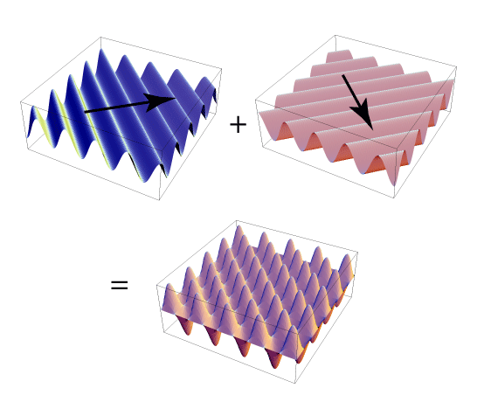
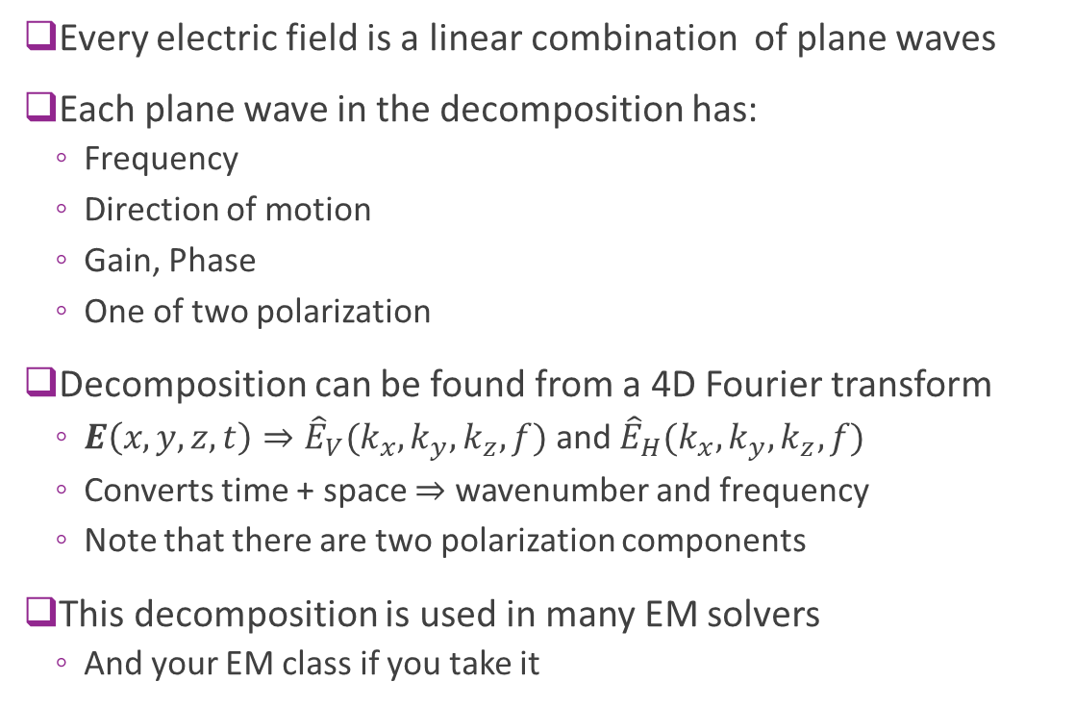
Plane Wave Decomposition
Every electric field is a linear combination of plane waves
Each plane wave in the decomposition has:
Frequency
Direction of motion
Gain, Phase
One of two polarization
Decomposition can be found from a 4D Fourier transform
$E\left(x,y,z,t\right)⇒{\hat{E}}_{V}(k_{x},k_{y},k_{z},f)$ and ${\hat{E}}_{H}(k_{x},k_{y},k_{z},f)$
Converts time + space $⇒$ wavenumber and frequency
Note that there are two polarization components
This decomposition is used in many EM solvers
And your EM class if you take it

Slide 11
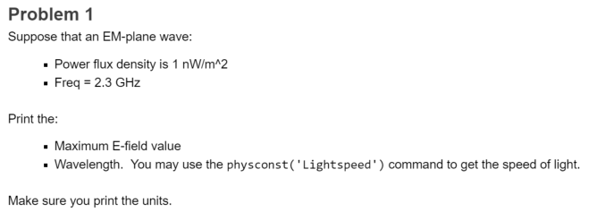
In-Class Problem

Slide 12
Outline
Basics of Electromagnetic Waves
Power and Bandwidth of Signals
Basics of Antennas
Free Space Propagation
Frames of Reference and Rotations

Slide 13
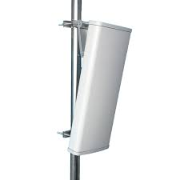
Signals for Communication
Antenna
TX signal
Carries information
EM radiation
Signal: Any quantity that varies in time
Continuous, discrete, complex, real, …
Signals for wireless communications:
Modulate an information bearing signal to a signal in the EM radiation
Three key characteristics of the signal: power, bandwidth, center frequency

Slide 14
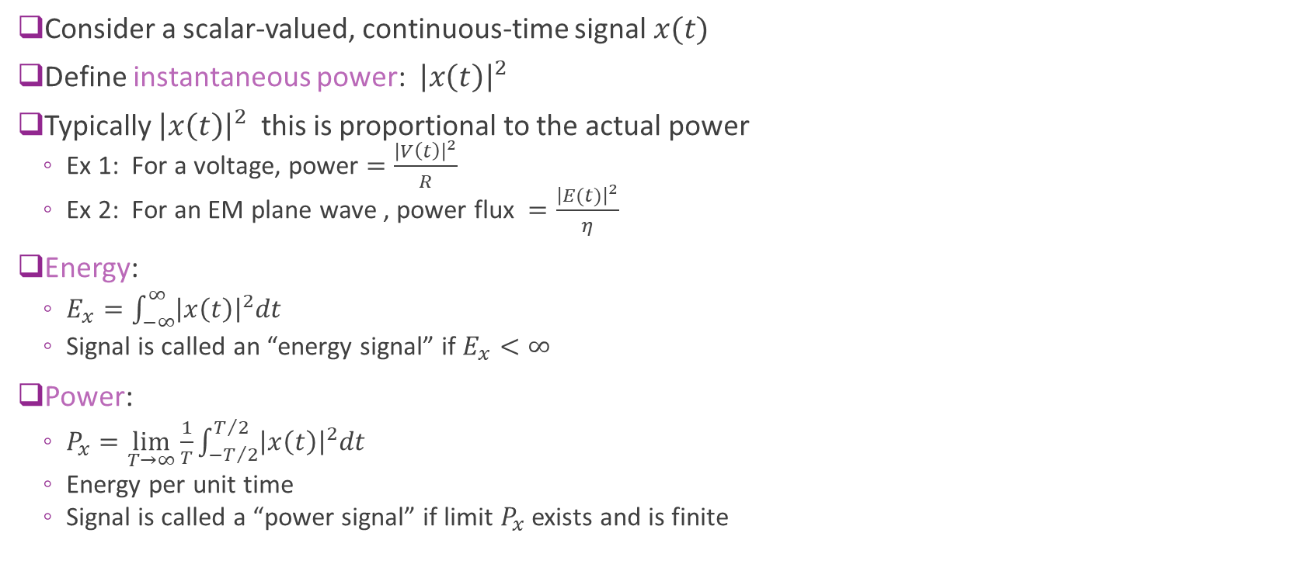
Energy and Power of Signals
Consider a scalar-valued, continuous-time signal $x(t)$
Define instantaneous power: ${\left|x\left(t\right)\right|}^{2}$
Typically ${\left|x\left(t\right)\right|}^{2}$ this is proportional to the actual power
Ex 1: For a voltage, power $=\frac{{\left|V\left(t\right)\right|}^{2}}{R}$
Ex 2: For an EM plane wave , power flux $=\frac{{\left|E(t)\right|}^{2}}{η}$
Energy:
$E_{x}=\int_{−∞}^{∞}{{\left|x\left(t\right)\right|}^{2}dt}$
Signal is called an “energy signal” if $E_{x}<∞$
Power:
$P_{x}=\lim_{T→∞}{\frac{1}{T}}\int_{−T/2}^{T/2}{{\left|x\left(t\right)\right|}^{2}dt}$
Energy per unit time
Signal is called a “power signal” if limit $P_{x}$ exists and is finite

Slide 15
Power: Linear and Decibel scale
Linear scale units
Power measured in Watts (W) or mW
Power values in W or mW called linear scale
Energy measured in Joules (J) or mJ
Power often measured in dB scale:
P_{dBW} = 10log₁₀(P_{W} / 1W)
P_{dBm} = 10log₁₀(P_{mW} / 1mW)
E_{dBmJ} = 10log₁₀(E_{mJ} / 1mJ)
dB scale is preferred since wireless signals have very large range
Example: P = 250 mW (typical max mobile transmit power)
In dBW: P = 10log₁₀(0.25W / 1W)=-6 dBW
In dBm: P = 10log₁₀(250mW / 1mW)=24 dBm

Slide 16
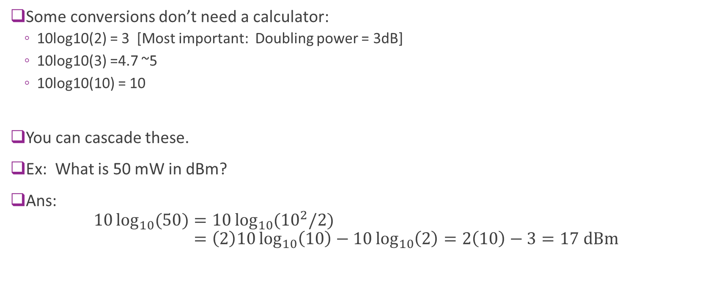
Some important dB values
Some conversions don’t need a calculator:
10log10(2) = 3 [Most important: Doubling power = 3dB]
10log10(3) =4.7 ~5
10log10(10) = 10
You can cascade these.
Ex: What is 50 mW in dBm?
Ans: $10\log_{10}{(50)}=10\log_{10}{({10}^{2}/2)}$ $=\left(2\right)10\log_{10}\left(10\right)−10\log_{10}\left(2\right)=2\left(10\right)−3=17 \text{dBm}$

Slide 17

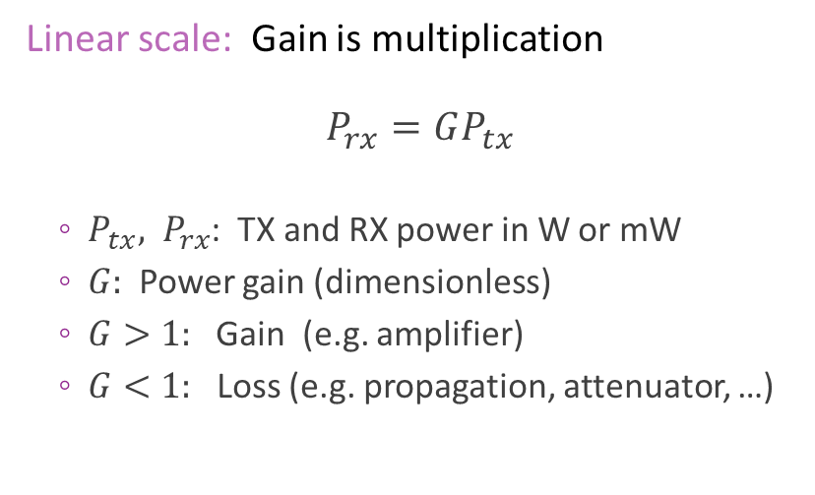
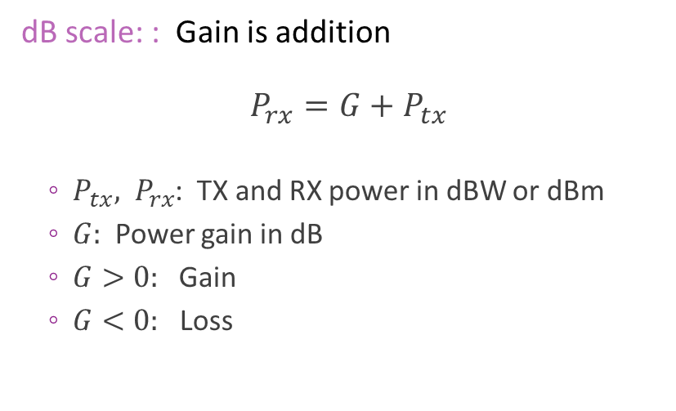
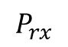
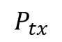
Gain and Loss in dB
TX
$$P_{tx}$$
$$P_{rx}$$
RX
Channel power gain $G$
Linear scale: Gain is multiplication $$P_{rx}=GP_{tx}$$
$P_{tx}, P_{rx}$: TX and RX power in W or mW
$G:$ Power gain (dimensionless)
$G>1:$Gain (e.g. amplifier)
$G<1:$ Loss (e.g. propagation, attenuator, …)
dB scale: : Gain is addition $$P_{rx}=G+P_{tx}$$
$P_{tx}, P_{rx}$: TX and RX power in dBW or dBm
$G:$ Power gain in dB
$G>0:$Gain
$G<0:$ Loss

Slide 18
Typical Wireless Power Transmit Levels
100 kW = 80 dBm: Typical FM radio transmission with 50 km radius
1 kW = 60 dBm: Microwave oven element (most of this doesn’t escape)
~300 W = 55 dBm: Geostationary satellite
250 mW = 24 dBm: Cellular phone maximum power (class 2)
200 mW = 23 dBm: WiFi access point
32 mW = 15 dBm: WiFi transmitter in a laptop
4 mW = 6 dBm: Bluetooth 10 m range
1 mW = 0 dBm: Bluetooth, 1 m range

Slide 19
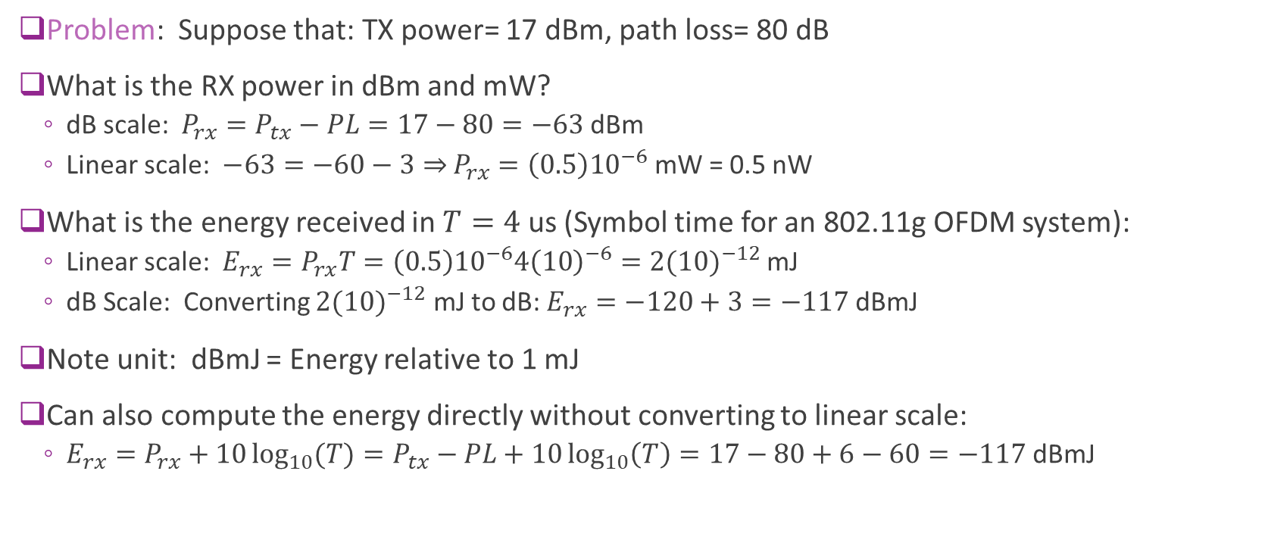
Example: Power and Time Calculation
Problem: Suppose that: TX power= 17 dBm, path loss= 80 dB
What is the RX power in dBm and mW?
dB scale: $P_{rx}=P_{tx}−PL=17−80=−63$ dBm
Linear scale: $−63=−60−3⇒$ $P_{rx}=\left(0.5\right){10}^{−6}$mW = 0.5 nW
What is the energy received in $T=4$ us (Symbol time for an 802.11g OFDM system):
Linear scale: $E_{rx}=P_{rx}T=\left(0.5\right){10}^{−6}4{\left(10\right)}^{−6}={2(10)}^{−12}$ mJ
dB Scale: Converting ${2(10)}^{−12}$ mJ to dB: $E_{rx}=−120+3=−117$dBmJ
Note unit: dBmJ = Energy relative to 1 mJ
Can also compute the energy directly without converting to linear scale:
$E_{rx}=P_{rx}+10\log_{10}{(T)}=P_{tx}−PL+10\log_{10}\left(T\right)=17−80+6−60=−117$dBmJ

Slide 20
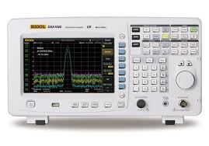
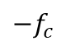


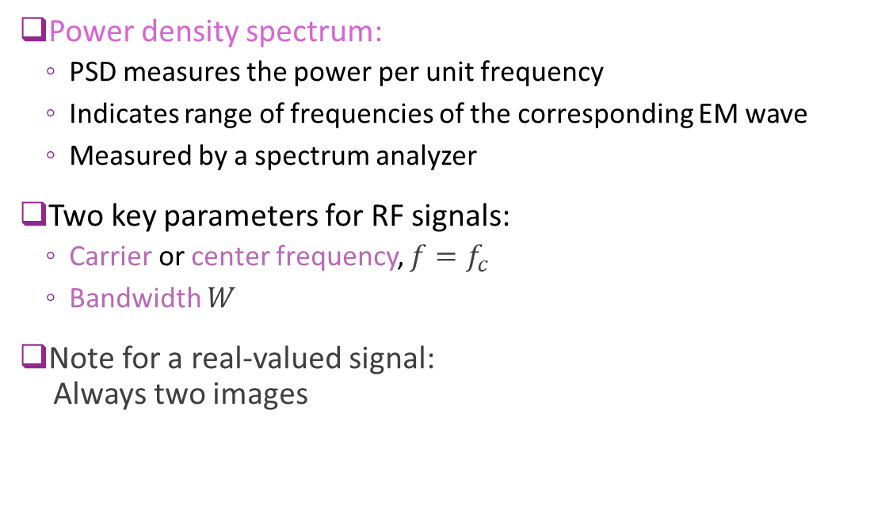
Bandwidth and Carrier Frequency
Power density spectrum:
PSD measures the power per unit frequency
Indicates range of frequencies of the corresponding EM wave
Measured by a spectrum analyzer
Two key parameters for RF signals:
Carrier or center frequency, $f=f_{c}$
Bandwidth $W$
Note for a real-valued signal: Always two images
$${−f}_{c}$$
0
$$f_{c}$$
$$W$$

Slide 21
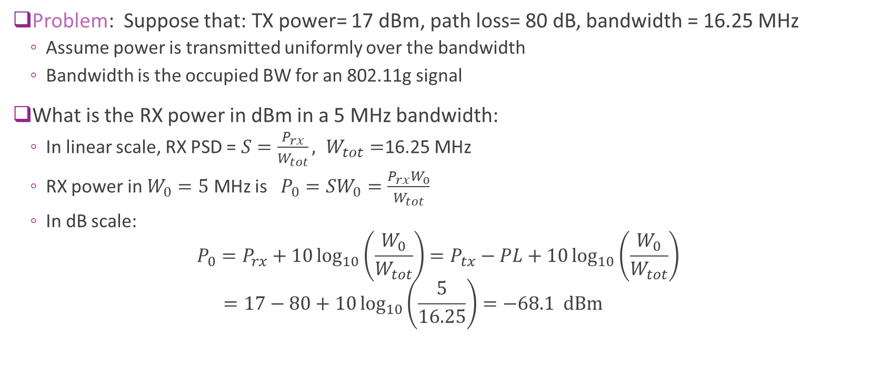
Example: PSD Calculation
Problem: Suppose that: TX power= 17 dBm, path loss= 80 dB, bandwidth = 16.25 MHz
Assume power is transmitted uniformly over the bandwidth
Bandwidth is the occupied BW for an 802.11g signal
What is the RX power in dBm in a 5 MHz bandwidth:
In linear scale, RX PSD = $S=\frac{P_{rx}}{W_{tot}}, W_{tot}=$16.25 MHz
RX power in $W_{0}=5$ MHz is $P_{0}=SW_{0}=\frac{P_{rx}W_{0}}{W_{tot}}$
In dB scale: $P_{0}=P_{rx}+10\log_{10}\left(\frac{W_{0}}{W_{tot}}\right)=P_{tx}−PL+10\log_{10}\left(\frac{W_{0}}{W_{tot}}\right)$ $=17−80+10\log_{10}\left(\frac{5}{16.25}\right)=−68.1 dBm$

Slide 22
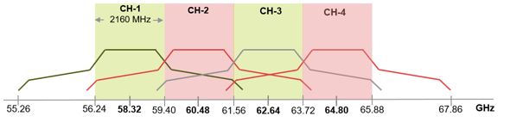
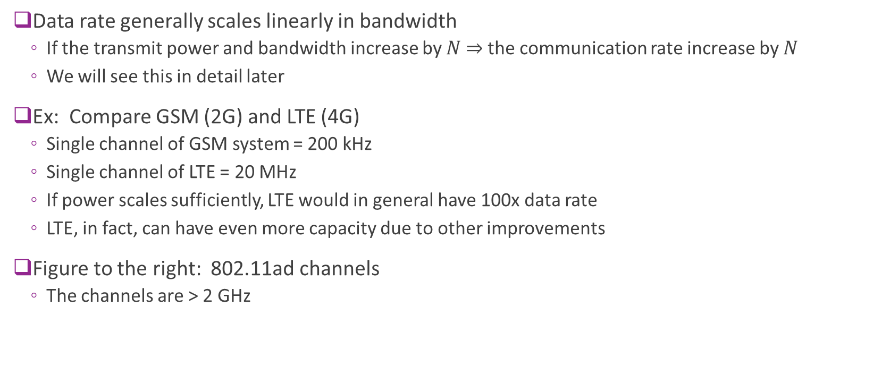
Importance of Bandwidth
Data rate generally scales linearly in bandwidth
If the transmit power and bandwidth increase by $N$ $⇒$ the communication rate increase by $N$
We will see this in detail later
Ex: Compare GSM (2G) and LTE (4G)
Single channel of GSM system = 200 kHz
Single channel of LTE = 20 MHz
If power scales sufficiently, LTE would in general have 100x data rate
LTE, in fact, can have even more capacity due to other improvements
Figure to the right: 802.11ad channels
The channels are > 2 GHz

Slide 23
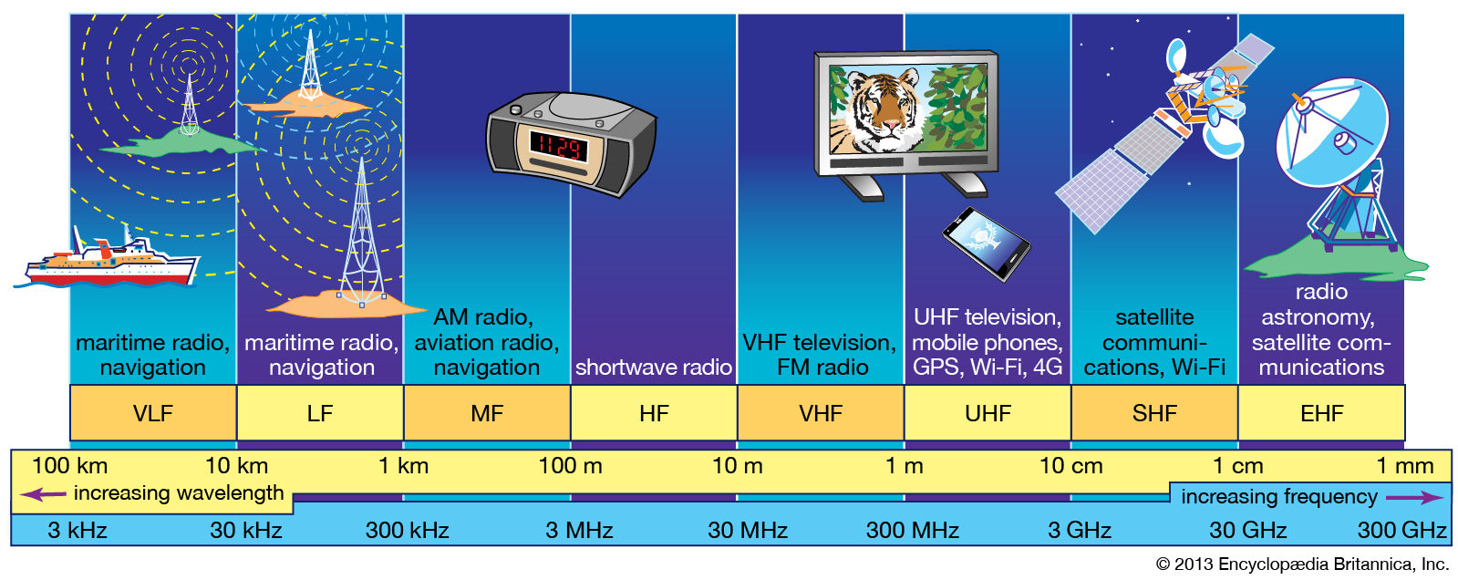
Radio Spectrum
Less bandwidth
More bandwidth
Greater Range
Less Range
Image: Britanica, https://www.britannica.com/science/radio-frequency-spectrum

Slide 24
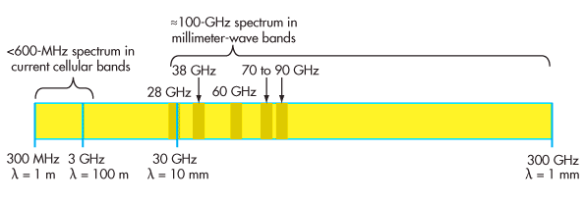
Millimeter Wave Bands
New bands for 5G
100x more bandwidth than conventional bands below 6 GHz
Bands at 28 GHz and 38 GHz opened up by FCC
5G systems operating have just started deployments

Slide 25



Next Frontier: Upper Mid-Band
FR1 sub-6 Traditional cellular
FR3 Upper Mid-band Potential 5G-Adv and 6G
FR2 mmWave Introduced in 5G
7 GHz
24 GHz
Balance of coverage & spectrum
More spectrum
Better coverage
Challenges with FR3
Wide bandwidth
Incumbents
Need for robustness
Satellite
RADAR
Malicious jammers

Slide 26
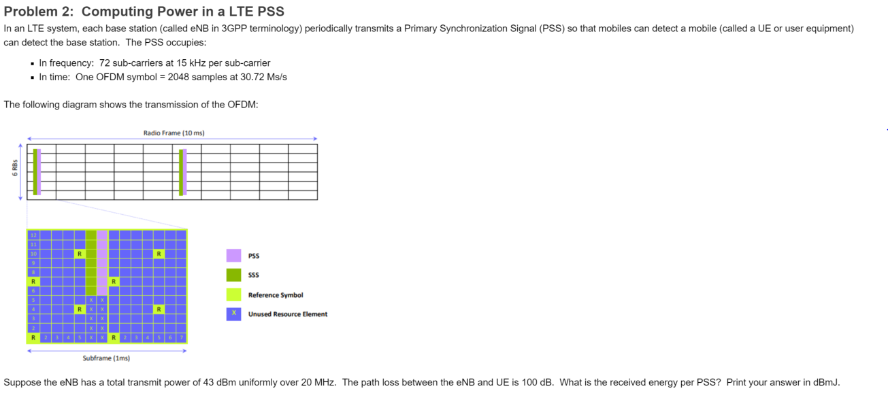
In-Class Exercise

Slide 27
Outline
Basics of Electromagnetic Waves
Power and Bandwidth of Signals
Basics of Antennas
Free Space Propagation
Frames of Reference and Rotations

Slide 28
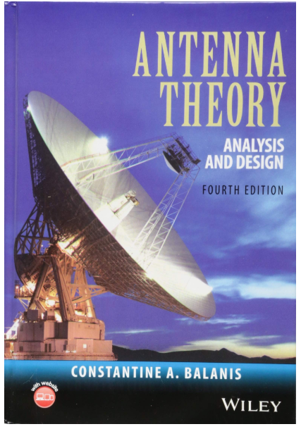
Excellent Text for Antennas
This lecture is based on classic text
Balanis, “Antenna Theory”
Most of the figures here are from this text
If you want to learn more, study the text:
Provides full EM theory view
Many excellent problems and examples
Designed for RF engineers
We will use only a small portion here
Take an EM class for more!

Slide 29
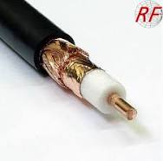
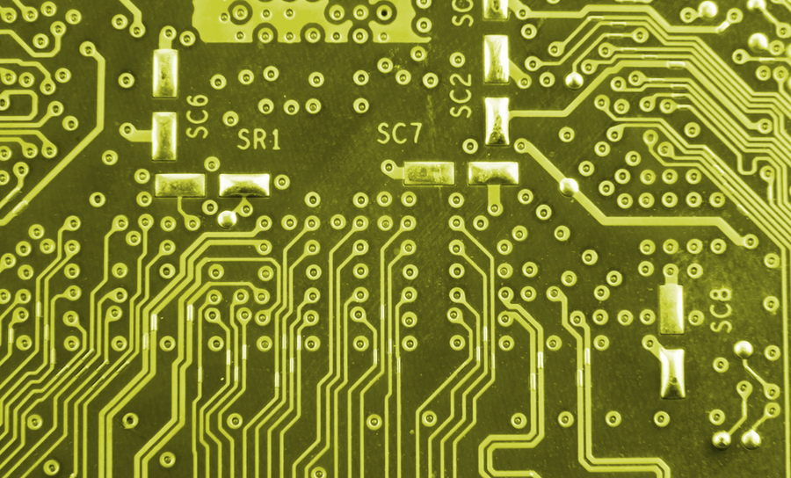

Waveguides and Transmission Lines
Transmission lines and waveguides: Any structure to guide waves with minimal loss
Some texts:
Transmission lines refer to conductors and waveguides to hollow structures
Many examples
PCB traces
Microstrip: External layer
Stripline: Internal layer
Coaxial cable
Waveguide

Slide 30
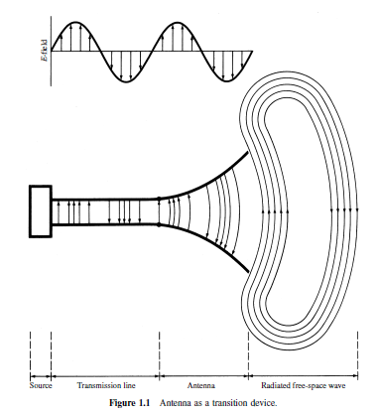
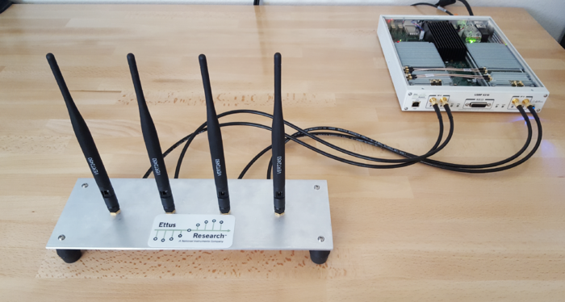
Antenna
Transmit antenna: Radiates electromagnetic waves
Converts signals:
From guided signals in transmission lines to
To radiation in free space
Receive antenna: Collects EM wave
USRP with four vertical antenas

Slide 31
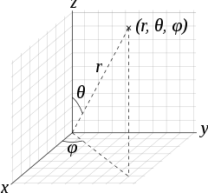
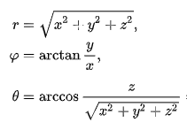
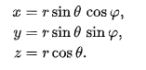
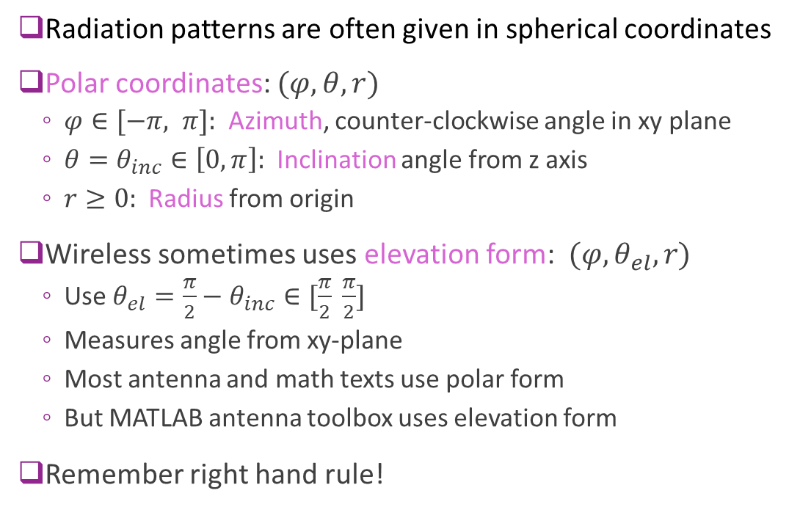

Spherical Coordinates
Radiation patterns are often given in spherical coordinates
Polar coordinates: $(φ, θ, r)$
$φ∈[−π, π]:$ Azimuth, counter-clockwise angle in xy plane
$θ=θ_{inc}∈\left[0,π\right]:$ Inclination angle from z axis
$r≥0:$ Radius from origin
Wireless sometimes uses elevation form: $(φ, θ_{el}, r)$
Use $θ_{el}=\frac{π}{2}−θ_{inc}∈[\frac{π}{2} \frac{π}{2}]$
Measures angle from xy-plane
Most antenna and math texts use polar form
But MATLAB antenna toolbox uses elevation form
Remember right hand rule!
Polar coordinates
Spherical (polar form) $⇔$ Cartesian

Slide 32
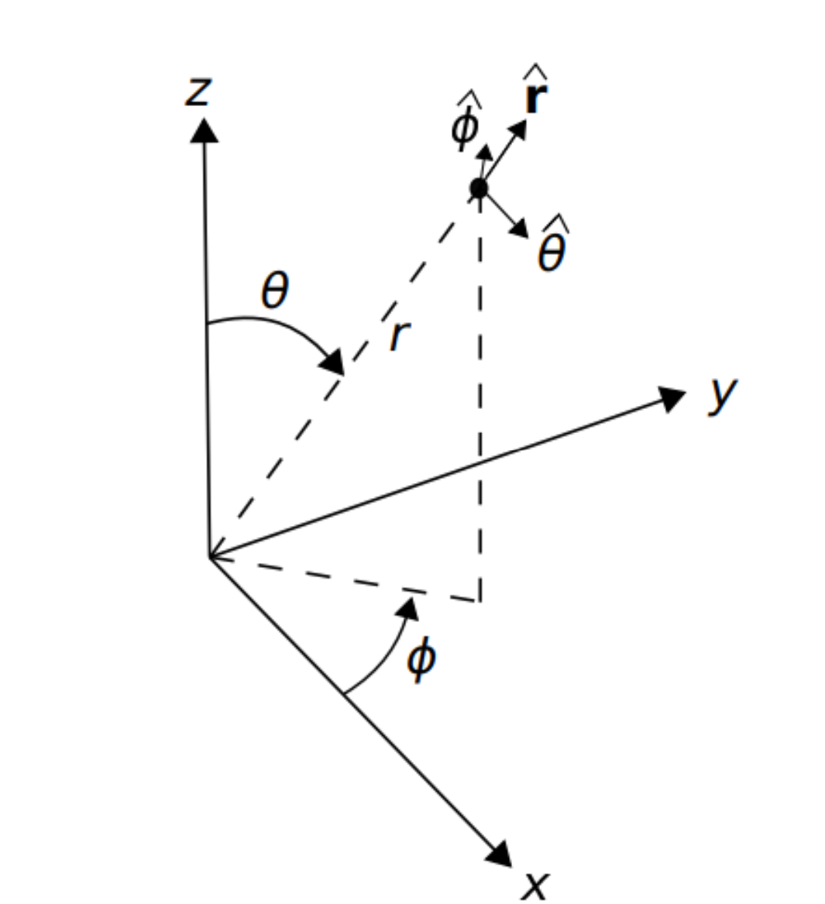
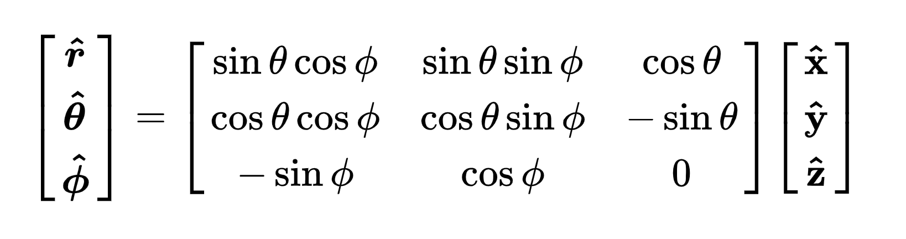
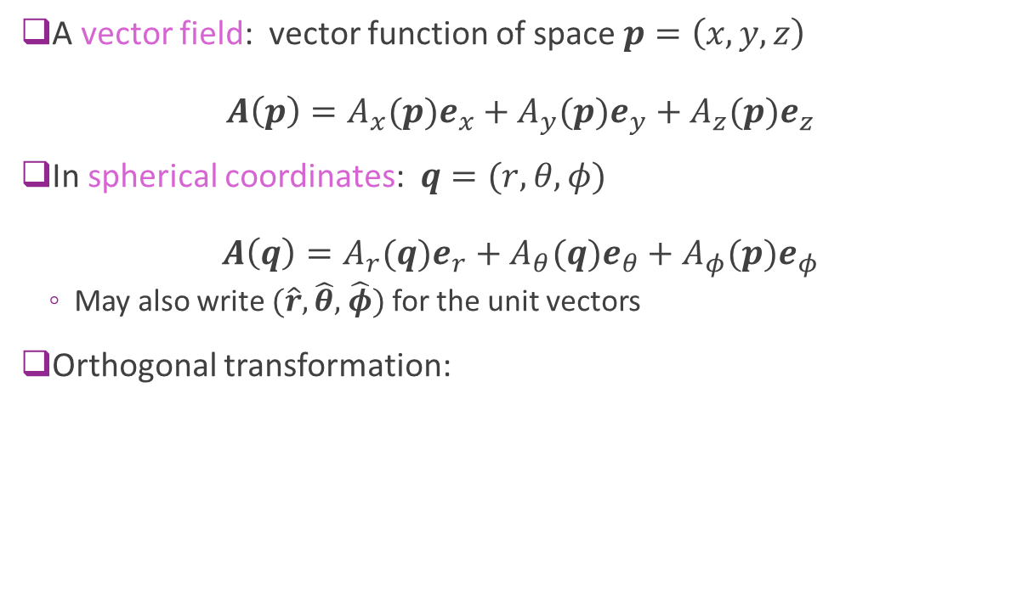
Spherical Vector Fields
A vector field: vector function of space $p=\left(x,y,z\right)$ $A\left(p\right)=A_{x}(p)e_{x}+A_{y}(p)e_{y}+A_{z}(p)e_{z}$
In spherical coordinates: $q=(r,θ,φ)$ $A\left(q\right)=A_{r}(q)e_{r}+A_{θ}(q)e_{θ}+A_{φ}(p)e_{φ}$
May also write $(\hat{r},\hat{θ},$ $\hat{φ})$ for the unit vectors
Orthogonal transformation:

Slide 33
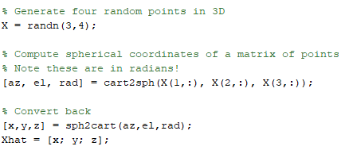
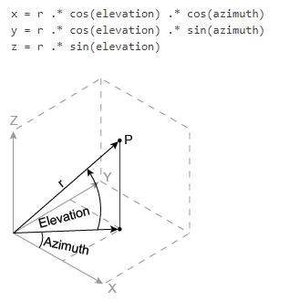
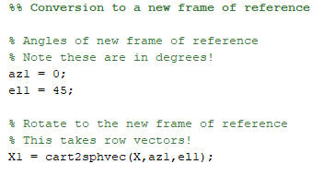
Spherical Coordinates in MATLAB
Conversion between spherical and cartesian
Conversion to a coordinate system

Slide 34



Fields from an Infinitesimal Current Source
Consider infinitesimal dipole of length $ℓ$
Current is $I={I_{0}e}_{z}$ at frequency $ω$
It can be shown that in the far-field (see Balanis):
Magnetic field $H=\frac{jI_{0}kℓ\sin{θ}}{4πr}e^{−kr}e_{φ}$ (direction $I×e_{r}$ )
Electric field $E=\frac{jηI_{0}kℓ\sin{θ}}{4πr}e^{−kr}e_{θ}, k=\frac{2π}{λ}$ (direction $H×e_{r}$)
Poynting vector: $S=\frac{η}{8}{\left|\frac{I_{0}ℓ}{λ}\right|}^{2} \frac{\sin^{2}{θ}}{r^{2}}e_{r}$
Notes:
$θ$ is inclination angle in above formulae
$E$ and $H$ decay as $1/r$ and are tangent to the sphere
$S$ decays at $1/r^{2}$ and is outward normal to the sphere
The fields for any antenna:
Can be computed by integrating the current density

Slide 35


Radiation Patterns
Aantenna radiation typically shown via a pattern
Value of scalar as a function of position
Antenna usually at origin
Orientation of the antenna is important
Many possible quantities:
Power, electric field, …
Normalized or un-normalized
Can be 2D or 3D
2D
3D

Slide 36

Radiation Density
Each infinitesimal current source contributes Poynting vector: $S=\frac{η}{8}{\left|\frac{I_{0}ℓ}{λ}\right|}^{2} \frac{\sin^{2}{θ}}{r^{2}}e_{r}=\frac{1}{2η}{\left\|E\right\|}^{2}e_{r}$
Integrating the currents across the antenna we have (in far-field): $S=We_{r}$
Radiation density: $W=W\left(r,θ,φ\right)=\frac{1}{2η}{\left|E\left(r,θ,φ\right)\right|}^{2}=$ radiation density
Power radiating outward from the sphere
Units $W/m^{2}$
This is a function of position $W\left(r,θ,φ\right)$

Slide 37




Radians and Steradians
Radian:
Circle of radius one
Angle for unit length on circumference
$2π$ radians in the circle
Steradian
Defined on sphere of radius one
Angles corresponding to unit area on surface
$4π$ sr in the sphere
Infinitesimal area and solid angle:
Note: $θ$ is the inclination angle not elevation

Slide 38

Radiation Intensity
From previous slide: Radiation density: $W=W\left(r,θ,φ\right)=\frac{1}{2η}{\left|E\left(r,θ,φ\right)\right|}^{2}$
Units $\frac{W}{m^{2}}$
Also define radiation intensity: $U=r^{2}W=\frac{r^{2}}{2η}{\left|E\left(r,θ,φ\right)\right|}^{2}$
Watts per solid angle: $\frac{W}{sr}$
In far field, radiation pattern typically decays as:
$E\left(r,θ,φ\right)≈\frac{1}{r}E_{0}\left(θ,φ\right)$
In this case, $U\left(r,θ,φ\right)=r^{2}W\left(r,θ,φ\right)=\frac{r^{2}}{2η}{\left|E\left(r,θ,φ\right)\right|}^{2}≈\frac{1}{2η}{\left|E_{0}\left(θ,φ\right)\right|}^{2}$
Only depends on angular position $U\left(r,θ,φ\right)=U\left(θ,φ\right)$
Does not depend on distance $r$

Slide 39

Total Radiated Power
Total radiated power: $P_{rad}=\iint{UdΩ}=\int_{−π/2}^{π/2}{\int_{−π}^{π}{U\left(θ,φ\right)\cos{θ}dφdθ}}$
Units is Watts
Note $\cos{θ}$term! Angle here is elevation angle not polar angle
Typically measured in dBm or dBW:
$P_{rad}\left[\text{dBm}\right]=10\log_{10}\left[\frac{P_{rad}}{1 \text{mW}}\right],P_{rad}\left[\text{dB}\text{W}\right]=10\log_{10}\left[\frac{P_{rad}}{1 \text{W}}\right]$
Power relative to mW or W

Slide 40




Example Problem
Problem: Total radiated power: $P_{rad}=30$ dBm
Assume power is uniformly radiated
At distance of 2 km, what is the power that strikes a 1 cm x 2 cm surface?
Solution:
Since power is uniform, radiation density is $W=\frac{P_{tx}}{4πd^{2}}$
RX power in small area is $P_{rx}=AW=\frac{AP_{tx}}{4πd^{2}}$
Area in m^2, $A=2{\left(10\right)}^{−4} m^{2}$
In dB scale: $P_{rx}=P_{tx}+10\log_{10}\left(\frac{A}{4πd^{2}}\right)=30+10\log_{10}\left(\frac{2{\left(10\right)}^{−4}}{4π{(2000)}^{2}}\right)=−84 dBm$
$d=$ 2 km
$$A=2 {\text{cm}}^{2}$$
$P_{tx}=30$ dBm

Slide 41


Isotropic Antenna
Isotropic antenna: Radiates uniformly in all directions
Radiation density and intensity are uniform
Radiation density: $W\left(θ,φ,r^{2}\right)=\frac{P_{rad}}{4πr^{2}}$
Radiation intensity: $U\left(θ,φ\right)=\frac{P_{rad}}{4π}$
Do not depend on angles $θ,φ$
Mostly theoretical construct:
Most real antennas have some “directivity”
In fact, there can be no coherent (linearly polarized) isotropic radiator
E-field would be always tangent to sphere
Such an E-field would have to go to zero in at least one point (“Hairy Ball Theorem”)
Theoretical isotropic pattern

Slide 42



Antenna Directivity
Most real antennas concentrate power in certain angles
They are non-isotropic
Antenna directivity:
$D\left(θ,φ\right)=\frac{4πU\left(θ,φ\right)}{P_{rad}}$ [dimensionless]
Measures power at an angle relative to average
Average in linear domain is one
For isotropic antenna, $D\left(θ,φ\right)=1$
Max directivity: $D_{max}=\max{D\left(θ,φ\right)}$
Directivity in direction with maximum power
Typically measured in dBi
dB relative to isotropic
$D\left(θ,φ\right) \left[dBi\right]=10\log\left[\frac{4πU\left(θ,φ\right)}{P_{rad}}\right]$
Theoretical isotropic antenna
Horn antenna with directivity

Slide 43




Antenna Gain and Efficiency
Most antennas have losses
Define efficiency: $ε=\frac{P_{rad}}{P_{in}}∈[0,1]$
Radiated to input power in TX mode
Remaining power is lost in heat in the antenna
Losses in the conductor and dielectric
Lossless antenna: $ε=1$
Antenna gain:
$G\left(θ,φ\right)=εD\left(θ,φ\right)=\frac{4πU\left(θ,φ\right)}{P_{in}}$
Radiation intensity per unit input power
For losses antennas, gain = directivity
Losses / heat
$$P_{rad}$$
Radiated power
$$P_{in}$$
Input power

Slide 44


Antenna Toolbox in MATLAB
Powerful routines for:
Design and analysis of antennas
Benefits:
Supports many antennas
Accurate EM modeling
Nice visualization tools
Simple to use
Also, free to NYU students
Just download it with MATLAB
But…very slow for complex antennas

Slide 45




Patterns in MATLAB: Dipole Example
MATLAB has powerful tools for calculating antenna patterns

Slide 46


Microstrip Patch Example
A more complex antenna
Many other parameters
Substrate selection (e.g. FR4, Rogers)
Shapes, notches, …

Slide 47



More Complex Antennas
For complex antennas:
MATLAB antenna toolbox is often too slow
Cannot handle packaging, covers, obstacles, …
Need other tools (e.g. Ansoft HFSS and CST)
Use MATLAB custom antenna object
Store offline computed pattern
CST simulation of 28 GHz array on a handset with cover https://blogs.3ds.com/simulia/5g-antenna-design-mobile-phones/
Demo of custom antenna element in MATLAB

Slide 48


Field Regions
Antenna patterns depend on the region
Reactive near field:
Reactive pattern dominates
Radiating near field or Fresnel region:
Angular pattern depends on distance
Far field or Fraunhofer region:
Angular pattern independent of distance
Radiation is approximately plane waves
Can be approximately calculated using:
$D:$ Maximum antenna dimension
$λ:$ Wavelength

Slide 49


Rayleigh Distance
Distance $R_{2}$ to far-field = Rayleigh distance
Most cellular / WLAN systems operate in far field
Ex 1: Half wavelength dipole antenna
$f_{c}$ = 2.3 GHz:
$D=\frac{λ}{2}, R_{2}=\frac{2D^{2}}{λ}=\frac{λ}{2}=6.5$ cm
Ex 2: Large cellular base station
$D≈7$m, $f_{c}$ = 2.3 GHz
$R_{2}=751$ m
Ex 3: MmWave wide aperture antenna
$D≈40$ cm, $f_{c}$ = 140 GHz
$R_{2}=149$ m

Slide 50


In-Class Exercise

Slide 51
Outline
Basics of Electromagnetic Waves
Power and Bandwidth of Signals
Basics of Antennas
Free Space Propagation
Frames of Reference and Rotations

Slide 52


Antenna Effective Aperture
Suppose RX antenna sees incident plane wave
Assume polarization aligned to the antenna
The effective antenna aperture (or area): $A_{e}\left(θ,φ\right)=\frac{P_{L}}{W\left(θ,φ\right)} [m^{2}]$
$W=$ Power density of incident wave [W / $m^{2}$]
$P_{L}=$ Power delivered to load at the receiver [W]
The effective area that the antenna collects
We will see this is different than the physical aperture
$A_{e}$ will depend on the direction of arrival

Slide 53


Aperture and Directivity
From previous slide, effective aperture is: $A_{e}\left(θ,φ\right)=\frac{P_{L}}{W\left(θ,φ\right)}[m^{2}]$
Ratio of received power to incident radiation density
Aperture-directivity relation:
True for all lossless antennas
Proof: next slide
Consequence: Average aperture is always $\frac{λ^{2}}{4π}$
Why? $\frac{1}{4π}\iint{A_{e}\left(θ,φ\right)}\cos{θ}dθdφ=\frac{λ^{2}}{{\left(4π\right)}^{2}}\iint{D\left(θ,φ\right)}\cos{θ}dθdφ=\frac{λ^{2}}{4π}$
Independent of the physical size of the antenna!
$$A_{e}\left(θ,φ\right)=D\left(θ,φ\right) \frac{λ^{2}}{4π}$$

Slide 54








Reciprocity of Antennas
To prove aperture-directivity, we need reciprocity
Loosely stated: Channel between antennas in both directions are equal
Mathematically:
If Ant 1 Transmits: RX voltage / TX current $=\frac{V_{2}^{oc}}{I_{1}}$
If Ant 2 Transmits: RX voltage / TX current $=\frac{V_{1}^{oc}}{I_{2}}$
Reciprocity: $\frac{V_{2}^{oc}}{I_{1}}=\frac{V_{1}^{oc}}{I_{2}}$
Can show that with the same loads:
Power transfer in both directions are equal: $\frac{P_{r2}}{P_{t1}}=\frac{P_{t2}}{P_{r1}}$
Antenna 1
Antenna 2
$$I_{1}$$
$$I_{2}$$
$$+$$
$$+$$
$$V_{1}$$
$$V_{2}$$
$$−$$
$$−$$

Slide 55


Proof of the Aperture-Directivity Relation
Suppose Ant 1 transmits power $P_{t}$
Radiation density is: $W=\frac{D_{1}P_{t}}{4πR^{2}}$
Received power at Ant 2: $P_{r}=A_{2}W=\frac{A_{2}D_{1}P_{t}}{4πR^{2}}⇒\frac{P_{r}}{P_{t}}=\frac{A_{2}D_{1}}{4πR^{2}}$
TX from Ant 2, the gain must be the same: $\frac{P_{r}}{P_{t}}=\frac{A_{1}D_{2}}{4πR^{2}}$
This is a consequence of reciprocity
Hence, for any two antennas: $\frac{D_{1}}{A_{1}}=\frac{D_{2}}{A_{2}}$
From simple antenna calculations for a short dipole:
$D_{2}=\frac{3}{2}, A_{2}=\frac{3λ^{2}}{8π}⇒\frac{D_{2}}{A_{2}}=\frac{4π}{λ^{2}}$ (Needs basic EM theory)

Slide 56



Friis’ Law
Consider two lossless antennas in free space
From previous slide: $\frac{P_{r}}{P_{t}}=\frac{A_{1}D_{2}}{4πR^{2}}$
From aperture-directivity relation: $A_{1}=D_{1}\frac{λ^{2}}{4π}$
This leads to Friis’ Law (for lossless antennas):
Path loss is proportional to $R^{2}$
Path loss Inversely proportional to $λ^{2}⇒$ proportional to $f_{c}^{2}$
$$\frac{P_{r}}{P_{t}}=D_{1}D_{2}{\left(\frac{λ}{4πR}\right)}^{2}$$

Slide 57




Example: Calculating Path Loss
Suppose $f_{c}=2.3$ GHz, $d=500$ m, what is the omni directional path loss?
Omni-Directional path loss is path loss without the antenna gain
This is easily done in MATLAB:

Slide 58

Polarization
We know E-field in far-field behaves as:
$E\left(r,θ,φ\right)≈\frac{1}{r}\left[F_{V}\left(θ,φ\right)e_{θ}+F_{H}\left(θ,φ\right)e_{φ}\right]$
Since E-field decays at $\frac{1}{r}$ and is tangent to the sphere
We call:
$F_{V}\left(θ,φ\right)=$ vertical E-field pattern
$F_{H}\left(θ,φ\right)=$ horizontal E-field pattern
Define complex gain patterns:
$C_{V}={\sqrt{\frac{4π}{2ηP_{rad}}}F}_{V}$ and $C_{H}=\sqrt{\frac{4π}{2ηP_{rad}}}F_{H}$
Define polarization vector: $C\left(θ, φ\right)=C_{V}\left(θ,φ\right)e_{θ}+$ $C_{H}\left(θ,φ\right)e_{φ}$
Vector is in direction of E-field
Then directivity is: $G\left(θ,φ\right)={\left|C_{V}\left(θ,φ\right)\right|}^{2}+{\left|C_{H}\left(θ,φ\right)\right|}^{2}={\left\|C\left(θ, φ\right)\right\|}^{2}$
This convention is used in Nvidia Sionna

Slide 59







Complex Channel Gain
Friis’ Law:
Provides power gain, not complex channel
Assumes aligned polarization
To compute complex channel gain for arbitrary polarization
Find angle of departure at TX: $Ω^{t}=\left(θ^{t}, φ^{t}\right)$
Find angle of arrival at RX: $Ω^{r}=\left(θ^{r}, φ^{r}\right)$
Find TX complex gain patterns: $C^{t}\left(Ω^{t}\right)=C_{V}^{t}\left(Ω^{t}\right)e_{θ}+C_{H}^{t}\left(Ω^{t}\right)e_{φ}$
Find RX complex gain patterns: $C^{r}\left(Ω^{r}\right)=C_{V}^{r}\left(Ω^{r}\right)e_{θ}+C_{H}^{r}\left(Ω^{r}\right)e_{φ}$
Complex channel gain will be: $H=C^{t}\left(Ω^{t}\right)⋅C^{r}\left(Ω^{r}\right)e^{−kr}\frac{λ}{4πr}$
TX
$$C_{V}^{t}$$
$$Ω^{t}$$
$$C_{H}^{t}$$
$$C_{V}^{r}$$
$$C_{H}^{r}$$
$$Ω^{r}$$
RX
Inner product

Slide 60




Polarization Loss
From previous slide, complex channel gain is: $H=C^{t}\left(Ω^{t}\right)⋅C^{r}\left(Ω^{r}\right)e^{−kr}\frac{λ}{4πr}$
Power gain is: $\frac{P_{r}}{P_{t}}={\left|H\right|}^{2}={\left|C^{t}\left(Ω^{t}\right)⋅C^{r}\left(Ω^{r}\right)\right|}^{2}{\left(\frac{λ}{4πr}\right)}^{2}$
Define polarization unit vectors: $u^{t}=\frac{C^{t}}{\left\|C^{t}\right\|},u^{r}=\frac{C^{r}}{\left\|C^{r}\right\|}$
Since ${\left|C^{t}\left(Ω^{t}\right)\right|}^{2}=D_{t},{\left|C^{t}\left(Ω^{t}\right)\right|}^{2}=D_{r}$: $\frac{P_{r}}{P_{t}}={\left|H\right|}^{2}=D_{t}D_{r}{\left(\frac{λ}{4πr}\right)}^{2}\cos^{2}{φ}$
Polarization loss: $u^{t}⋅u^{r}=\cos^{2}{φ}$ loss due misalignment in polarization
Often quoted in dB: $F=20\log_{10}{\cos{φ}}$
$$C^{r}\left(Ω^{r}\right)$$
$$C^{t}\left(Ω^{r}\right)$$
$$φ$$

Slide 61









Ex: Rotation Orthogonal to Path Direction
Consider two antennas:
TX at $(0,0,0)$, RX at $(r,0,0)$. Both vertically polarized
TX: AoD $θ^{t}=φ^{t}=0$.
H-field is in direction $I_{t}×r∝e_{z}×e_{x}=e_{y}$
E-field & TX pol vector $C_{t}∝H×r∝e_{y}×e_{x}=e_{z}$
RX antenna is rotated around $y$ axis by $α$
AoA relative to antenna: $θ^{r}=−α, φ^{r}=0$
H-field is in direction $I_{r}×r∝I_{r}×e_{x}∝e_{y}$
E-field & RX pol vector $C_{t}∝H×r∝e_{y}×e_{x}=e_{z}$
Path loss = $D_{t}(0,0)D_{r}(−α,0){\left(\frac{λ}{4πr}\right)}^{2}$
$$e_{z}$$
$$C_{t}$$
$$C_{r}$$
$$I_{r}$$
$$I_{t}$$
$$e_{y}$$
TX
$$α$$
RX
$$e_{x}$$
Polarization vectors aligned
Boresight not aligned
Rotation along axis orthogonal to path direction causes no polarization loss

Slide 62


Ex: Rotation Around Path Direction
Consider two antennas:
TX at $(0,0,0)$, RX at $(r,0,0)$. Both vertically polarized
TX: AoD $θ^{t}=φ^{t}=0$.
H-field is in direction $I_{t}×r∝e_{z}×e_{x}=e_{y}$
E-field & TX pol vector $C_{t}∝H×r∝e_{y}×e_{x}=e_{z}$
RX antenna is rotated around $x$ axis by $γ$
AoA relative to antenna: $θ^{r}=0, φ^{r}=0$
$I_{r}∝(0,\sin{γ},\cos{γ)}$
H-field is in direction $I_{r}×r∝I_{r}×e_{x}∝(0,\cos{γ}, \sin{γ})$
E-field & RX pol vector $C_{t}∝H×r∝(0,\sin{γ},\cos{γ})$
Path loss = $D_{t}\left(0,0\right)D_{r}\left(00\right){\left(\frac{λ}{4πr}\right)}^{2}\cos^{2}{γ}$
$$e_{z}$$
$$C_{t}$$
$$C_{r}$$
$$I_{r}$$
$$I_{t}$$
$$e_{y}$$
$$γ$$
TX
RX
$$e_{x}$$
Polarization vectors not aligned
Boresight aligned
Rotation around axis of path direction causes polarization loss

Slide 63



Antenna Impedance and Matching
Not all power from radio may be delivered to antenna
Some is reflected back
Described by reflection coefficient $Γ$
Also referred to as $S_{11}$
Complex ratio of forward to reverse wave
Also described by impedance mismatch:
$Γ=$ $\frac{Z_{in}−Z_{0}}{Z_{in}+Z_{0}}$
Fraction of power transferred: $1−{\left|Γ\right|}^{2}$
Also given as voltage standing wave ratio (VSWR) $=\frac{1+\left|Γ\right|}{1−\left|Γ\right|}$
Ali et al, Small Form Factor PIFA Antenna Design at 28 GHz for 5G Applications, 2019

Slide 64


Friis’ Law with Losses
Three losses in practice:
Polarization loss
Conductive / dielectric loss
Impedance mismatch
Friis’ Law with lossy antennas:
$$\frac{P_{r}}{P_{t}}=ε_{1}ε_{2}(1−{\left|Γ_{1}\right|}^{2})(1−{\left|Γ_{2}\right|}^{2})D_{1}D_{2}{\left(\frac{λ}{4πR}\right)}^{2}\cos^{2}{θ_{POL}}$$
$ε_{i}$: Efficiency of antenna
$θ_{POL}$: Angle between the polarization vectors
Note that gain is: $G_{i}=ε_{i}D_{i}$

Slide 65


In-Class Exercise

Slide 66
Outline
Basics of Electromagnetic Waves
Power and Bandwidth of Signals
Basics of Antennas
Free Space Propagation
Frames of Reference and Rotations

Slide 67


Frames of Reference
Antenna patterns are usually given in a “local” frame of reference
A coordinate system in a fixed relation with the antenna structure
Ex: Coordinate aligned to the normal of a patch antenna
But antenna may have arbitrary alignment to the rest of environment
Ex, Base station antenna tilt and orientation
Alignment may move over time
Ex: Rotation or translation of a handset
Environment typically specified in “global” frame of reference
This section:
How to represent local and global coordinate systems
How to translate between the two

Slide 68



Rigid Body
Rigid body: Any structure with fixed relative distances
Body may be in motion
Ex: Handset, base station antenna, antenna mounted on a car, …
Rigid body’s configuration described by two properties
Position of some reference point in the body:
$p=\left(p_{x},p_{y},p_{z}\right)∈ℝ^{3}$
Orientation around that point:
Described by orthonormal vectors ${\{\hat{x}}_{b},{\hat{y}}_{b},{\hat{z}}_{b}\}$
Motion: Change of position and orientation over time

Slide 69

Frames of Reference for Antennas
Global frame of reference: An arbitrary coordinate system, typically fixed
Assume aligned at the origin with basis ${\hat{x}}_{s}, {\hat{y}}_{s}, {\hat{z}}_{s}$
Body or local frame of reference:
A coordinate system for a rigid body possibly in motion
Translation $p$ and basis ${\hat{x}}_{b}\text{, }{\hat{y}}_{b},{\hat{z}}_{b}$ in the global basis
Antenna systems
Typ. Given antenna patterns in local frame of reference
Signal paths given in global frame of reference
Need to translate global to local

Slide 70





Euler Angles
Rotation matrices in $ℝ^{3}$ are typically described by three Euler angles
Robotics naming:
Yaw $α$: Rotation round $z$ axis, corresponds to azimuth angle
Pitch $β$: Rotation round $y$ axis, corresponds to inclination angle
Roll $γ$: Rotation around $x$ axis
Rotation matrix given by a product
Note order matters. Many different conventions. This product is XYZ:
https://en.wikipedia.org/wiki/Euler_angles
https://en.wikipedia.org/wiki/Rotation_matrix

Slide 71


Computing Rotation Matrices in MATLAB
MATLAB has many tools to compute rotation matrices
Eul2rotm:
Give angles in radians
Give order, e.g. ‘ZYX’
See demo in github

Slide 72


Example: Frame of Reference of a Moving Object
See MATLAB demo
Object moving in 3D space (e.g., UAV)
Antenna pointed in direction of motion

Slide 73


Find Angles of Arrival along Path
Find the angles in RX frame of reference
RX away from TX
RX facing TX
RX above TX

Slide 74


Find Gain along Path
Compute omni-directional path loss and gain along path

Slide 75


Computing the Polarization Loss
Compute the E-field H and V patterns
Then perform interpolation on path
Code for interpolation in demo
Not shown on slide due to space
Assume TX is V pol
RX polarization vector:
Unit vector in direction of E-field
Use MATLAB built-in polloss function
Computes angle between TX and RX pol vectors
Accounts for rotation of TX and RX

Slide 76

Polarization Loss
In this case, loss is minimal
Loss is ~0.01 dB
Minimal rotation around path direction

Slide 77



Nvidia Sionna Demo
Demo in github for calculations with Nvidia Sionna
Performs all geometric calculations
Easy tensorflow interface

